Slide 1

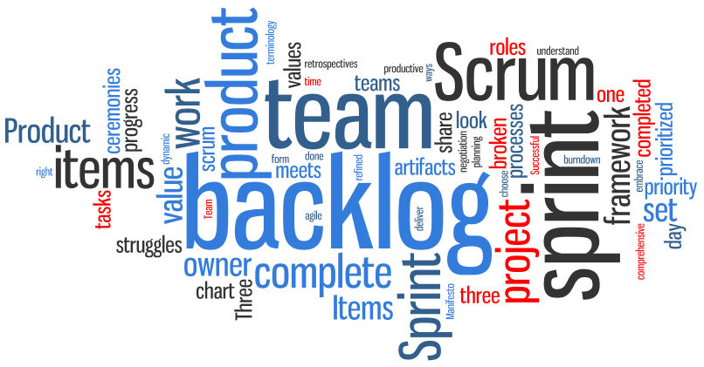
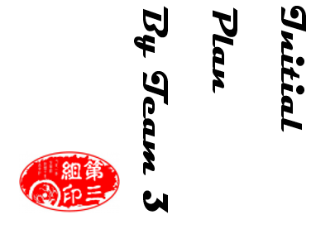
Sprint ZERO
Notes:
‹#›
Hello everyone, this is the Initial plan report by Team 3. We pick up the outline and important information to show you because of limited time. As you see, the name of our product is ProPal. Here is the Logo, it is designed by Yansen our … leader.

Slide 2

Overview
Initial Plan
*
‹#›
ProPal
Web Application
Agile Methodology
Notes:
‹#›
First, let’s start with introducing our product. Our product is a web application. Obviously it is used on browser. We will use html5, CSS and Javascript, so it will work well for major browsers, chrome, safari, firefox. About web server, we already registered our domain and we will turn on the host when we finish major features. Also, the business logic is based on Scrum, one of the Agile management method. We’ll talk details later. Then, for database, we use MySQL which is embedded on the host.

Slide 3
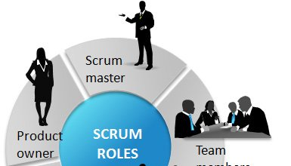

Overview
Initial Plan
*
‹#›
Motivation
User Friendly
Multi-User
Notes:
‹#›
Why we develop this? Firstly we see the previous team’s work. It is a good desktop app and works well, but the installation is desperate. So we decide to make this web application. It is user friendly and no installation. Also, Agile method is usually based on multiple roles, so, for multi-users, web application is the best solution. On the other hand, web application is easier to update. We don’t want our product to be a toy. For the team from next semester, we will have all the documentations they need. And all they have to do is turn on the host and add more features and functions on this application.

Slide 4
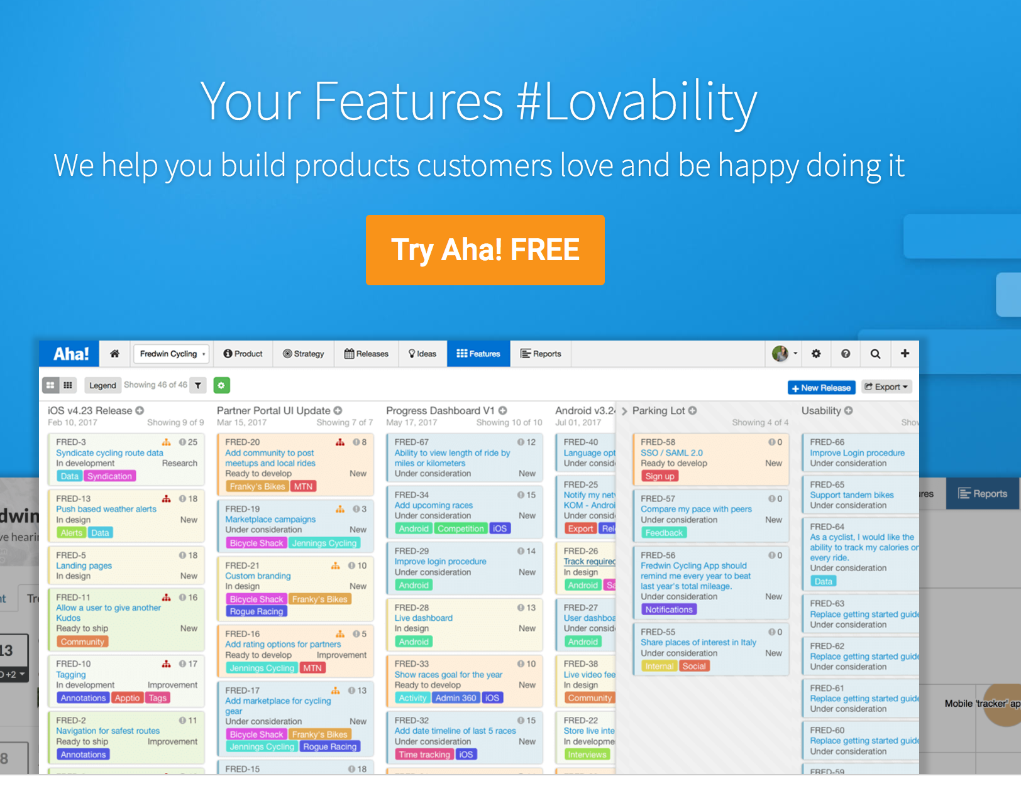
Related Work
Initial Plan
*
Aha!
Aha! allows you to manage a sprint like Pivotal.
But it is designed for product teams and based around the idea that you need to link your product strategy to your roadmaps to your development work. Otherwise, you can quickly build yourself to nowhere
Notes:
‹#›

Slide 5
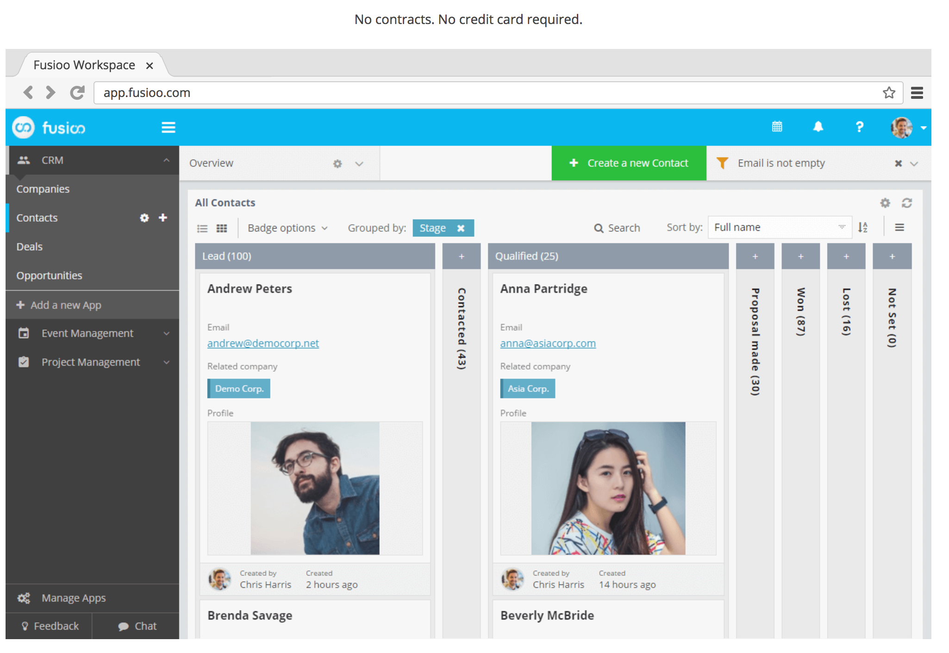
Related Work
Initial Plan
*
Fusioo
Fusioo is a customizable CRM and project management tool that allows teams to work the way they want to. Unlike other project management tools, with Fusioo you can set up your custom workspace to track and manage the information you need.
Notes:
‹#›

Slide 6

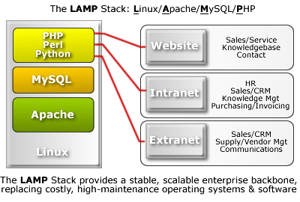

Software Architecture
Initial Plan
*
Notes:
‹#›

Slide 7
User cases
Registered users - developer(invited)
Product Developer
Owner
Invite users
Create requirements
Assign requirements
Finish requirements
Finish projects

Slide 8
User cases
Registered users - product owner
Product
Owner
Create projects
Create requirements
Finish requirements
Finish projects

Slide 9
Functional requirement
All users: Create account, Privacy Policy
Registered users:
Product owner:
Login, project and requirement (create, delete or finish)
View finished and deteled history(desirable feature)
Security questions, personal biography(optional)
Developer: View and finish assigned requirements.
Scrum master: View all requirements.

Slide 10



Nonfunctional requirement
Language - English
Response time: 3 seconds
Difficulty of using : Application shall be very easy to use and intuitive
Host server: Digital Ocean
Tools:
Database - MySQL
IDE - Intellij
Local LAMP environment - MAMP
Scalability : 100 concurrent users
Site security: the site salt and hash user passwords and prevent basic SQL injection

Slide 11

Initial Plan
*
Quality Assurance
Metrics: Products Metrics & Process Metrics
Standard: Documentation Standard & Coding Standard
Testing:
Defect Management:
Defect Severity is a classification of software defect (bug) to indicate the degree of negative impact on the quality of software
Defect priority determines how quickly the defect turnaround time must be
Tools: Plutora Test, Backlog
Notes:
‹#›

Slide 12
Management Plan
Process Model
Scrum ---- Major Model
eXtreme Programming---Risk Management
Notes:
This part is tricky because we use it to manage our product and it is also the content of our product in the meanwhile. I will discuss our management plan and product content at the same time from two aspects: Process model and Risk management.

Slide 13
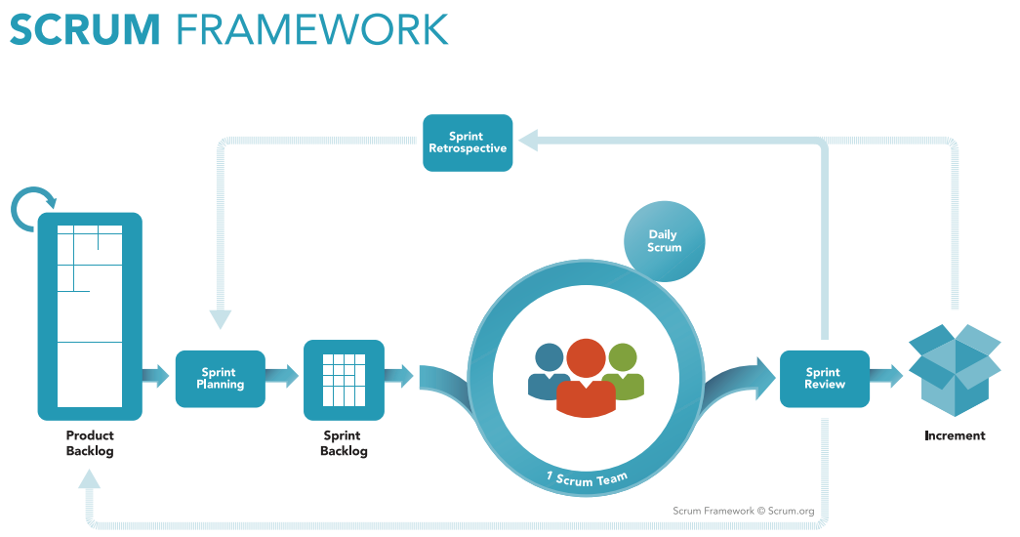
Initial Plan
Notes:
Here is the process model. We use Scrum. Here is the basic framework of Scrum. Product backlog is fully detailed requirement. That is important because when all the backlogs are finished our product is finished and fully functional. So this part is one of the crucial works from our Initial plan. It is also the foundation of risk management. After the first step, we will go to the Iteration (or sprint, same meaning) 1 increment, iteration 2 increment, until all the backlogs are finished. In each sprint, we will do sprint planning and have sprint backlog, that means we pick the high priority backlogs to sprint backlog. Then we coding we summary current sprint compare our plan. Then we have increments.

Slide 14
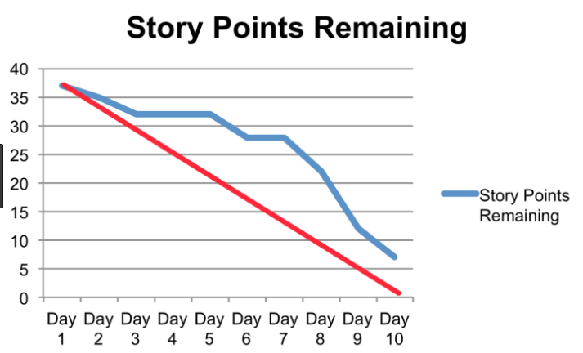

Slide 15
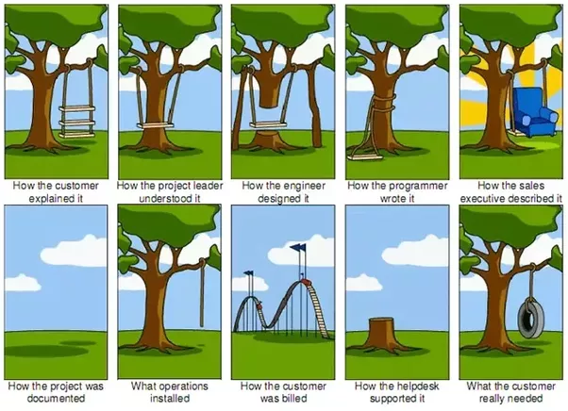
Management Plan(con.)
Risk Management
Project risks (e.g.)
Retire
Fully detailed project backlogs
Sprint summary

Slide 16
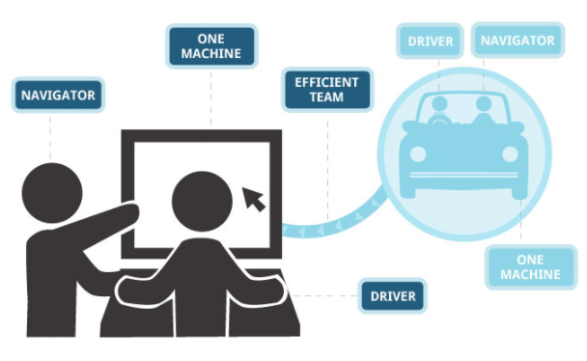
Management Plan(con.)
Risk Management
Technical risks
XP:
Pair programming

Slide 17

Configuration Management Plan
Initial Plan
*
Configuration items and tools
Development:
Version Control Tool: Git and Github
Github : https://github.com/buse2017fall/SoftwareEngineering
IDE : Intellij and Eclipse
Environment : Windows, Linux and Mac OS
Deployment:
Host: Digital Ocean
Domain: Free Domain
FTP: Fillezilla
Architect:
Web: LAMP ( Linux + Apache + MySQL + PHP )
Test on Local : MAMP
Notes:
‹#›

Slide 18
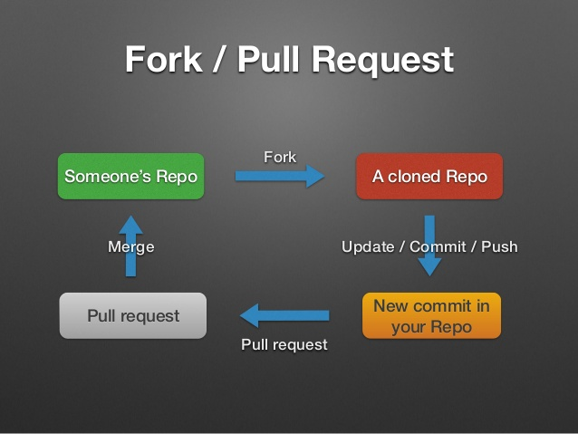
Configuration Management Plan
Initial Plan
*
Notes:
‹#›

Slide 19
Initial Plan
*
Change and branch management
Only configuration leader have the access to main account (Github)
Developers use their own github account to fork the project repository
Developers can create master and child branch on their own github and local machine
Developers can push to their own github account freely
If developers want to push to the main account, he or she has to pull new request on github, then configuration leader will check the code and decide if merge request or not
Since we use git and github, it is easy to rollback to specific version
Notes:
‹#›

Slide 20

Branch Management
Initial Plan
*
Master branch - final and deliverable branch
Feature branch - used to test new feature
More branches may be needed based on the future requirements
Notes:
‹#›

Slide 21
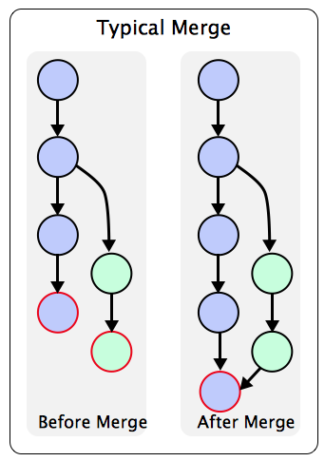
Initial Plan
*
Code commit guidelines
Each time before you change your local code , please following those steps:
Git fetch upstream
Git merge upstream/master
Git add <file>
Git commit -m “message”
Git push
Go to your own Github to create new pull request
Notes:
‹#›

Slide 22
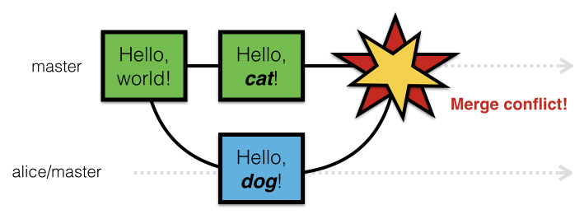
Initial Plan
*
Code commit guidelines
What if there is conflicts ? How to solve it ?
After fetch and merge, if there is conflicts , please follow those steps
open <file_where_conflicts_occur>
Delete >>>>>> , ======, <<<<<<<
Save and quit
Git add <file>
Git commit -m “message”
Git push
Go to your own Github to create new pull request
Notes:
‹#›

Slide 23
Initial Plan
*
Reference
Nelson, Megan. "An Intro to Git and GitHub for Beginners", www.product.hubspot.com/blog/git-and-github-tutorial-for-beginners. Accessed 18 Sep 2017.
Usability.gov, user cases. “https://www.usability.gov/how-to-and-tools/methods/use-cases.html”
Notes:
‹#›

